Slide 1


Course Introduction
Date

Slide 2
Introduce your self …

Slide 3
set rules together to make our course has more fun ;)

Slide 4
Course Road Map
•
Getting Started with Spring and Hibernate: Dev Environment
•
Apply Spring Inversion of Control / Dependency Injection
•
Perform object/relational mapping with Hibernate
•
Leverage the Hibernate API to develop CRUD apps
•
Create web application using Spring MVC
•
Create Spring APIs using Spring Rest
•
AOP Aspect Oriented Programming
•
Using Spring Boot to build Spring Data REST Project

Slide 5
Why Spring?
•
Very popular framework for building Java applications
•
Initially a simpler and lightweight alternative to J2EE
•
you have to make few, if any, changes to your application code
to gain the benefits of Spring Core
•
Provides a large number of helper classes … makes things easier

Slide 6

But What About J2EE???
Client-Side Presentation
Server-Side Presentation
Server-Side Business Logic
Database

Slide 7



But What About Java EE???
J2EE 1.2
J2EE 1.3
J2EE 1.4
Java EE 5
Java EE 6
Java EE 7
Servlets JSP EJB JMS RMI
EJB CMP JCA
Web Services Mgmt Deployment
Ease of use EJB 3 JPA
JSF JAXB JAX-WS
Pruning, Ease of use JAX-RS CDI
Bean- Validation
JMS 2
Batch TX
Concurrenc y
Web Sockets
1999
2001
2003
2006
2009
2013

Slide 8
EJB v1 and v2 - Complexity
•
Early version of EJB (v1 and v2) were extremely complex!!!
EJB Client
Home Interface Home Object
Component Interface EJB Object
Bean Class
•
Multiple deployment descriptors
•
Multiple interfaces
•
Poor Performance of Entity Beans

Slide 9
Release Timeline
J2EE 1.2
J2EE 1.3
J2EE 1.4
Java EE 5
Java EE 6
Java EE 7
Java EE 8
1999
Java EE
2001
2003
2006
2009
2013
2016/2017
Spring
Spring 1.0
Spring 2.0
Spring 3.0
Spring 4.0
Spring 4.3
2004
2006
2009
2013
Mar 2016

Slide 10

Spring Release Timeline - UPDATED
Spring 5
Spring 1.0
Spring 2.0
Spring 3.0
Spring 4.0
Spring 4.3
2004
2006
2009
2013
Mar 2016
Sep 2017

Slide 11
Spring Framework Overview

Slide 12

Spring Website - Official
www.spring.io

Slide 13
Why Spring?
Simplify Java Enterprise Development

Slide 14
Goals of Spring
•
Lightweight development with Java POJOs (Plain-Old-Java-Objects)
•
Dependency injection to promote loose coupling
•
Declarative programming with Aspect-Oriented-Programming (AOP)
•
Minimize boilerplate Java code

Slide 15





Core Container
Beans
Core
SpEL
Context

Slide 16
Spring Projects https://spring.io/projects

Slide 17
SET UP YOUR ENVIRONMENT
You Must Have the Java Development Kit (JDK) Installed
Java Application Server – Tomcat https://tomcat.apache.org/
Java Integrated Development Environment (IDE) – Eclipse https://www.eclipse.org/downloads/packages/

Slide 18
SET UP YOUR ENVIRONMENT(Cont)
Install Tomcat 9.0 on your Local machine
Install Eclipse
Connecting Eclipse and Tomcat

Slide 19

Downloading Spring JAR files

Slide 20
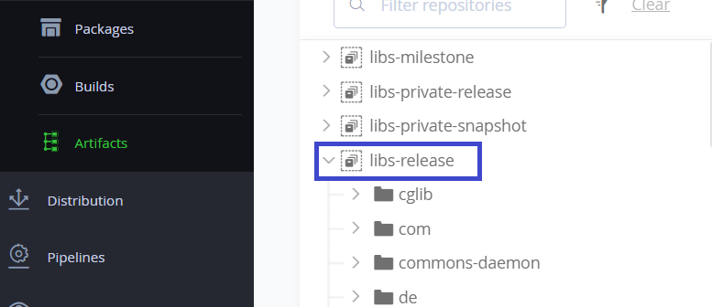
Spring repository
Notes:
Packages - repo.spring.io

Slide 21
To Do List
Create Eclipse Project
Download Spring JAR Files
Add JAR files to Eclipse Project … Build Path

Slide 22


What about Maven ???
Instead of manually downloading you can use a tool like Maven
If you are a Maven expert … go ahead and get started :-)
I want to keep the focus on Spring for now
KEEP CALM
and FOCUS YOUR
GOALS!

Slide 23

Inversion of Control (IoC)
The approach of outsourcing the
construction and management of objects.

Slide 24



Coding Scenario
getDailyWorkout()
My App
BaseballCoach
•
App should be configurable
•
Easily change the coach for another sport
•
Hockey, Cricket, Tennis, Gymnastics etc …

Slide 25
Code Demo
•
MyApp.java: main method
•
BaseballCoach.java
•
Coach.java: interface after refactoring
•
TrackCoach.java

Slide 26


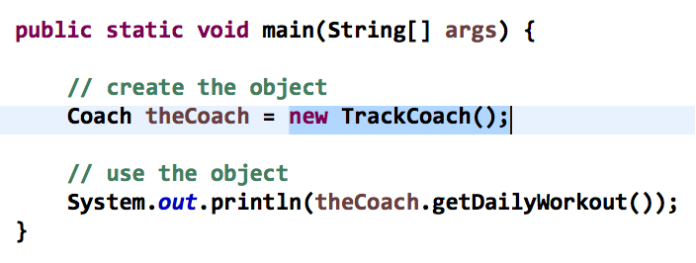



Ideal Solution
Object Factory
give me a “Coach” object
My App
configuration
BaseballCoach
CricketCoach
HockeyCoach

Slide 27
Ideal Solution
Object Factory
give me a “Coach” object
My App
configuration
BaseballCoach
CricketCoach
HockeyCoach

Slide 28
Spring Container
Spring
Object Factory
give me a “Coach” object
My App
configuration
BaseballCoach
CricketCoach
HockeyCoach

Slide 29

Spring Container
Spring
•
Primary functions
Object Factory
•
Create and manage objects (Inversion of Control)
•
Inject object’s dependencies (Dependency Injection)

Slide 30
Configuring Spring Container
•
XML configuration file (legacy, but most legacy apps still use this)
•
Java Annotations (modern)
•
Java Source Code (modern)

Slide 31
Spring Development Process
Step-By-Step
Configure your Spring Beans
Create a Spring Container
Retrieve Beans from Spring Container

Slide 32

Step 1: Configure your Spring Beans
File: applicationContext.xml
<beans … >
<bean id="myCoach" class="com.luv2code.springdemo.BaseballCoach">
</bean>
</beans>

Slide 33

Step 2: Create a Spring Container
Spring container is generically known as ApplicationContext
Specialized implementations
ClassPathXmlApplicationContext
AnnotationConfigApplicationContext
GenericWebApplicationContext
others …
Spring
Object Factory

Slide 34

Step 2: Create a Spring Container
ClassPathXmlApplicationContext context =
new ClassPathXmlApplicationContext("applicationContext.xml");

Slide 35



Step 3: Retrieve Beans from Container
Spring
Object Factory
give me a “Coach” object
My App
configuration
BaseballCoach
CricketCoach
HockeyCoach

Slide 36


Step 3: Retrieve Beans from Container
// create a spring container ClassPathXmlApplicationContext context =
new ClassPathXmlApplicationContext("applicationContext.xml");
// retrieve bean from spring container
Coach theCoach = context.getBean("myCoach", Coach.class);
File: applicationContext.xml
<bean id="myCoach"
class="com.luv2code.springdemo.BaseballCoach">
</bean>

Slide 37

Dependency Injection
The dependency inversion principle.
The client delegates to calls to another object the responsibility of providing its dependencies.

Slide 38


Spring Container
Spring
Object Factory
give me a “Coach” object
My App
configuration
dependencies (helper objects)
BaseballCoach
HockeyCoach
CricketCoach
dependencies (helper objects)
dependencies (helper objects)

Slide 39

Demo Example
Our Coach already provides daily workouts
•
Now will also provide daily fortunes
New helper: FortuneService
This is a dependency
Coach
FortuneService

Slide 40
Injection Types
There are many types of injection with Spring
•
We will cover the two most common
Constructor Injection
Setter Injection
•
Will talk about “auto-wiring” in the Annotations section later

Slide 41
Development Process - Constructor Injection
Define the dependency interface and class
Create a constructor in your class for injections
Configure the dependency injection in Spring config file
Step-By-Step

Slide 42


Step 1: Define the dependency interface and class
File: FortuneService.java
public interface FortuneService {
public String getFortune();
}
File: HappyFortuneService.java
public class HappyFortuneService implements FortuneService {
public String getFortune() {
return "Today is your lucky day!";
}
}

Slide 43

Step 2: Create a constructor in your class for injections
File: BaseballCoach.java
public class BaseballCoach implements Coach {
private FortuneService fortuneService;
public BaseballCoach(FortuneService theFortuneService) { fortuneService = theFortuneService;
}
...
}

Slide 44

Step 3: Configure the dependency injection in Spring config file
File: applicationContext.xml
<bean id="myFortuneService" class="com.luv2code.springdemo.HappyFortuneService">
</bean>
<bean id="myCoach" class="com.luv2code.springdemo.BaseballCoach">
<constructor-arg ref="myFortuneService" />
</bean>

Slide 45
Spring Container
Spring
Object Factory
give me a “Coach” object
My App
configuration
No Assembly
Required
dependencies (helper objects)
BaseballCoach
HockeyCoach
CricketCoach
dependencies (helper objects)
dependencies (helper objects)

Slide 46

Constructor Injection - Behind the Scenes

Slide 47
How Spring Processes your Config File
File: applicationContext.xml
<bean id="myFortuneService" class="com.luv2code.springdemo.HappyFortuneService">
</bean>
<bean id="myCoach" class="com.luv2code.springdemo.BaseballCoach">
<constructor-arg ref="myFortuneService" />
</bean>

Slide 48

The Spring Framework will perform operations
behind the scenes for you :-)

Slide 49


How Spring Processes your Config File
<bean id="myFortuneService" class="com.luv2code.springdemo.HappyFortuneService">
</bean>
<bean id="myCoach" class="com.luv2code.springdemo.BaseballCoach">
<constructor-arg ref="myFortuneService" />
</bean>
Spring Framework
HappyFortuneService myFortuneService =
new HappyFortuneService();
BaseballCoach myCoach =
new BaseballCoach(myFortuneService);

Slide 50
Setter Injection

Slide 51
Inject dependencies by calling
setter method(s) on your class

Slide 52
Development Process - Setter Injection
Step-By-Step
Create setter method(s) in your class for injections
Configure the dependency injection in Spring config file

Slide 53

Step1: Create setter method(s) in your class for injections
File: CricketCoach.java
public class CricketCoach implements Coach {
private FortuneService fortuneService; public CricketCoach() {
}
public void setFortuneService(FortuneService fortuneService) { this.fortuneService = fortuneService;
}
...
}

Slide 54

Step 2: Configure the dependency injection in Spring config file
File: applicationContext.xml
<bean id="myFortuneService" class="com.luv2code.springdemo.HappyFortuneService">
</bean>
<bean id="myCricketCoach" class="com.luv2code.springdemo.CricketCoach">
<property name="fortuneService" ref="myFortuneService" />
</bean>

Slide 55


Call setter method on Java class
<property name="fortuneService" ref="myFortuneService" />
public void setFortuneService(…)

Slide 56

Call setter method on Java class
<property name="bestAthlete" ref=“…” />
public void setBestAthlete(…)

Slide 57


How Spring Processes your Config File
<bean id="myFortuneService" class="com.luv2code.springdemo.HappyFortuneService">
</bean>
Spring Framework
HappyFortuneService myFortuneService =
new HappyFortuneService();

Slide 58

How Spring Processes your Config File
<bean id="myFortuneService" class="com.luv2code.springdemo.HappyFortuneService">
</bean>
Spring Framework
HappyFortuneService myFortuneService =
new HappyFortuneService();
<bean id="myCricketCoach" class="com.luv2code.springdemo.CricketCoach">
<property name="fortuneService" ref="myFortuneService" />
Spring Framework
</bean>
CricketCoach myCricketCoach = new CricketCoach();
myCricketCoach.setFortuneService(myFortuneService);

Slide 59
Injecting Literal Values

Slide 60

Injecting Literal Values
emailAddress: thebestcoach@luv2code.com
team: Sunrisers Hyderabad
CricketCoach
FortuneService

Slide 61
Development Process
Step-By-Step
Create setter method(s) in your class for injections
Configure the injection in Spring config file

Slide 62

Step1: Create setter method(s) in your class for injections
File: CricketCoach.java
public class CricketCoach implements Coach {
private String emailAddress;
private String team;
public void setEmailAddress(String emailAddress) ...
public void setTeam(String team) ...
...
}

Slide 63

Step 2: Configure the injection in Spring config file
File: applicationContext.xml
<bean id="myCricketCoach" class="com.luv2code.springdemo.CricketCoach">
<property name="fortuneService" ref="myFortuneService" />
<property name="emailAddress" value="thebestcoach@luv2code.com" />
<property name="team" value="Sunrisers Hyderabad" />
</bean>

Slide 64
Injecting Values from Properties File

Slide 65
Read from a Properties File
emailAddress:
team:
properties file
CricketCoach
FortuneService

Slide 66
Development Process
Create Properties File
Load Properties File in Spring config file
Reference values from Properties File
Step-By-Step

Slide 67

Step 1: Create Properties File
File: sport.properties
foo.email=myeasycoach@luv2code.com foo.team=Royal Challengers Bangalore

Slide 68

Step 2: Load Properties file in Spring config file
File: applicationContext.xml
<context:property-placeholder location="classpath:sport.properties"/>

Slide 69


Step 3: Reference Values from Properties File
File: applicationContext.xml
<bean id="myCricketCoach" class="com.luv2code.springdemo.CricketCoach">
…
<property name="emailAddress" value="${foo.email}" />
<property name="team" value="${foo.team}" />
</bean>
foo.email=myeasycoach@luv2code.com foo.team=Royal Challengers Bangalore

Slide 70
Bean Scopes

Slide 71
Bean Scopes
Scope refers to the lifecycle of a bean
•
How long does the bean live?
•
How many instances are created?
•
How is the bean shared?

Slide 72

Default Scope: Singleton
<beans … >
<bean id="myCoach" class="com.luv2code.springdemo.TrackCoach">
…
</bean>
</beans>
www.luv2code.com

Slide 73
What Is a Singleton?
•
Spring Container creates only one instance of the bean, by default
•
It is cached in memory
•
All requests for the bean will return a SHARED reference to the same bean
•

Slide 74




What is a Singleton?
Spring
Coach theCoach = context.getBean("myCoach", Coach.class);
...
TrackCoach
Coach alphaCoach = context.getBean("myCoach", Coach.class);

Slide 75

Explicitly Specify Bean Scope
<beans … >
<bean id="myCoach" class="com.luv2code.springdemo.TrackCoach" scope="singleton">
…
</bean>
</beans>

Slide 76








Additional Spring Bean Scopes
Scope | Description
singleton | Create a single shared instance of the bean. Default scope.
prototype | Creates a new bean instance for each container request.
request | Scoped to an HTTP web request. Only used for web apps.
session | Scoped to an HTTP web session. Only used for web apps.
global-session | Scoped to a global HTTP web session. Only used for web apps.
Notes:
globalSession is something that is connected to Portlet applications. When your application works in a Portlet container it is built of some amount of portlets. Each portlet has its own session, but if you want to store variables global for all portlets in your application then you should store them in globalSession

Slide 77
Prototype Scope Example
Prototype scope: new object for each request
<beans … >
<bean id="myCoach" class="com.luv2code.springdemo.TrackCoach" scope="prototype">
…
</bean>
</beans>

Slide 78



Prototype Scope Example
Prototype scope: new object for each request
Spring
TrackCoach
Coach theCoach = context.getBean("myCoach", Coach.class);
...
Coach alphaCoach = context.getBean("myCoach", Coach.class);
TrackCoach

Slide 79
Bean Lifecycle Methods

Slide 80

Bean Lifecycle
Container Started
Bean Instantiated
Dependencies Injected
Internal Spring Processing
Your Custom Init Method
Bean Is Ready For Use
Container Is Shutdown
Your Custom Destroy Method

Slide 81
Bean Lifecycle Methods / Hooks
You can add custom code during bean initialization
Calling custom business logic methods
Setting up handles to resources (db, sockets, file etc)
•
You can add custom code during bean destruction
Calling custom business logic method
Clean up handles to resources (db, sockets, files etc)

Slide 82

Init: method configuration
<beans … >
<bean id="myCoach" class="com.luv2code.springdemo.TrackCoach"
init-method="doMyStartupStuff">
…
</bean>
</beans>

Slide 83

Destroy: method configuration
<beans … >
<bean id="myCoach" class="com.luv2code.springdemo.TrackCoach"
init-method="doMyStartupStuff"
destroy-method="doMyCleanupStuff">
…
</bean>
</beans>

Slide 84
Development Process
Step-By-Step
Define your methods for init and destroy
Configure the method names in Spring config file

Slide 85
Spring Configuration with Annotations

Slide 86


What are Java Annotations?
•
Special labels/markers added to Java classes
•
Provide meta-data about the class
Boot
Color: Silver Style: Jewel Code: 1460
SKU: 10072090
Size US: 8
Size UK: 6
•
Processed at compile time or run-time for special processing

Slide 87

Annotation Example
•
We’ve seen annotations already …
public class TrackCoach implements Coach {
@Override
public String getDailyWorkout() { return "Run a hard 5k";
}
…
}

Slide 88
Why Spring Configuration with Annotations?
•
XML configuration can be verbose
•
Configure your Spring beans with Annotations
•
Annotations minimizes the XML configuration

Slide 89
Scanning for Component Classes
•
Spring will scan your Java classes for special annotations
•
Automatically register the beans in the Spring container

Slide 90
Development Process
Enable component scanning in Spring config file
Add the @Component Annotation to your Java classes
Retrieve bean from Spring container
Step-By-Step

Slide 91

Step 1: Enable component scanning in Spring config file
<beans … >
<context:component-scan base-package="com.luv2code.springdemo" />
</beans>

Slide 92

Step 2: Add the @Component Annotation to your Java classes
@Component("myCoach")
public class TennisCoach implements Coach {
@Override
public String getDailyWorkout() {
return "Practice your backhand volley";
}
}

Slide 93

Step 3: Retrieve bean from Spring container
•
Same coding as before … nothing changes.
Coach theCoach = context.getBean("myCoach", Coach.class);

Slide 94
@Components – Default Bean ID

Slide 95
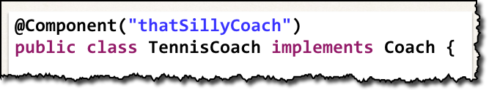
We already learned …
1. Specify the bean id in the component annotation

Slide 96


Spring also supports Default Bean IDs
•
Default bean id: the class name, make first letter lower-case
Class Name
Default Bean Id
TennisCoach
tennisCoach

Slide 97


Code example
Class Name
Default Bean Id
TennisCoach
tennisCoach

Slide 98
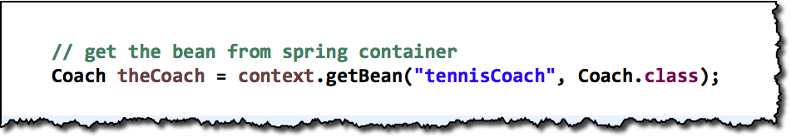
Code example

Slide 99
Code example
Class Name
Default Bean Id
HappyFortuneService
happyFortuneService

Slide 100
Spring Dependency Injection with Annotations and Autowiring

Slide 101

Demo Example
Our Coach already provides daily workouts
•
Now will also provide daily fortunes
New helper: FortuneService
This is a dependency
Coach
FortuneService

Slide 102

What is Spring AutoWiring?
Coach
For dependency injection, Spring can use auto wiring
FortuneService
•
Spring will look for a class that matches the property
matches by type: class or interface
•
Spring will inject it automatically … hence it is autowired

Slide 103

Autowiring Example
Coach
FortuneService
•
Injecting FortuneService into a Coach implementation
•
Spring will scan @Components
•
Any one implements FortuneService interface???
•
If so, let’s inject them. For example: HappyFortuneService

Slide 104
Autowiring Injection Types
Constructor Injection
•
Setter Injection
•
Field Injections

Slide 105
Development Process - Constructor Injection
Step-By-Step
Define the dependency interface and class
Create a constructor in your class for injections
Configure the dependency injection with @Autowired Annotation

Slide 106

Step 1: Define the dependency interface and class
File: FortuneService.java
public interface FortuneService {
public String getFortune();
}
File: HappyFortuneService.java
@Component
public class HappyFortuneService implements FortuneService {
public String getFortune() {
return "Today is your lucky day!";
}
}

Slide 107


Step 2: Create a constructor in your class for injections
Coach
File: TennisCoach.java
@Component
public class TennisCoach implements Coach {
FortuneService
private FortuneService fortuneService;
public TennisCoach(FortuneService theFortuneService) { fortuneService = theFortuneService;
}
...
}

Slide 108


Step 3: Configure the dependency injection @Autowired annotation
Coach
File: TennisCoach.java
@Component
public class TennisCoach implements Coach {
FortuneService
private FortuneService fortuneService;
@Autowired
public TennisCoach(FortuneService theFortuneService) { fortuneService = theFortuneService;
}
...
}

Slide 109
Spring Container
Spring
Object Factory
give me a “Coach” object
My App
configuration
No Assembly
Required
dependencies (helper objects)
BaseballCoach
HockeyCoach
CricketCoach
dependencies (helper objects)
dependencies (helper objects)

Slide 110
Setter Injection with Annotations and Autowiring

Slide 111
Inject dependencies by calling
setter method(s) on your class

Slide 112
Autowiring Example
Coach
FortuneService
•
Injecting FortuneService into a Coach implementation
•
Spring will scan @Components
•
Any one implements FortuneService interface???
•
If so, let’s inject them. For example: HappyFortuneService

Slide 113
Development Process - Setter Injection
Step-By-Step
Create setter method(s) in your class for injections
Configure the dependency injection with @Autowired Annotation

Slide 114

Step1: Create setter method(s) in your class for injections
File: TennisCoach.java
@Component
public class TennisCoach implements Coach {
private FortuneService fortuneService; public TennisCoach() {
}
public void setFortuneService(FortuneService fortuneService) { this.fortuneService = fortuneService;
}
...
}

Slide 115

Step 2: Configure the dependency injection with Autowired Annotation
File: TennisCoach.java
@Component
public class TennisCoach implements Coach {
private FortuneService fortuneService; public TennisCoach() {
}
@Autowired
public void setFortuneService(FortuneService fortuneService) { this.fortuneService = fortuneService;
}
...
}

Slide 116
Inject dependencies by calling
ANY method on your class Simply give: @Autowired

Slide 117

Step 2: Configure the dependency injection with Autowired Annotation
File: TennisCoach.java
@Component
public class TennisCoach implements Coach {
private FortuneService fortuneService; public TennisCoach() {
}
@Autowired
public void doSomeCrazyStuff(FortuneService fortuneService) { this.fortuneService = fortuneService;
}
...
}

Slide 118
Field Injection with Annotations and Autowiring

Slide 119
Inject dependencies by setting field values on your class directly
(even private fields)

Slide 120
Development Process - Field Injection
Step-By-Step
1. Configure the dependency injection with Autowired Annotation
✤
Applied directly to the field
✤
No need for setter methods

Slide 121

Step 1: Configure the dependency injection with Autowired Annotation
File: TennisCoach.java
public class TennisCoach implements Coach {
@Autowired
private FortuneService fortuneService;
public TennisCoach() {
}
// no need for setter methods
...
}

Slide 122
Spring Injection Types
Constructor Injection
Setter Injection
Choose a style
Stay consistent in your project
Field Injection

Slide 123
Annotation Autowiring and Qualifiers

Slide 124
Autowiring
Coach
FortuneService
•
Injecting FortuneService into a Coach implementation
•
Spring will scan @Components
•
Any one implements FortuneService interface???
•
If so, let’s inject them … oops which one?

Slide 125
Multiple FortuneService Implementations
FortuneService
HappyFortuneService
RESTFortuneService
RandomFortuneService
DatabaseFortuneService

Slide 126

Umm, we have a little problem ….
Error creating bean with name 'tennisCoach':
Injection of autowired dependencies failed
Caused by: org.springframework.beans.factory.NoUniqueBeanDefinitionException:
No qualifying bean of type [com.luv2code.springdemo.FortuneService] is defined: expected single matching bean but found 4:
databaseFortuneService,happyFortuneService,randomFortuneService,RESTFortuneService

Slide 127

Solution: Be specific! - @Qualifier
@Component
public class TennisCoach implements Coach {
@Autowired @Qualifier("happyFortuneService") private FortuneService fortuneService;
...
}

Slide 128
Injection Types
•
Can apply @Qualifier annotation to
Constructor injection
Setter injection methods
Field injection

Slide 129
Bean Scopes with Annotations

Slide 130

Explicitly Specify Bean Scope
@Component
@Scope("singleton")
public class TennisCoach implements Coach {
...
}

Slide 131
Prototype Scope Example
Prototype scope: new object for each request
@Component
@Scope("prototype")
public class TennisCoach implements Coach {
...
}

Slide 132
Bean Lifecycle Methods - Annotations

Slide 133

Init: method configuration
@Component
public class TennisCoach implements Coach {
@PostConstruct
public void doMyStartupStuff() { … }
...
}

Slide 134
Destroy: method configuration
@Component
public class TennisCoach implements Coach {
@PreDestroy
public void doMyCleanupStuff() { … }
...
}

Slide 135
Development Process
Step-By-Step
Define your methods for init and destroy
Add annotations: @PostConstruct and @PreDestroy

Slide 136
Spring Configuration with Java Code

Slide 137
Java Configuration
•
Instead of configuring Spring container using XML
•
Configure the Spring container with Java code
No XML!

Slide 138
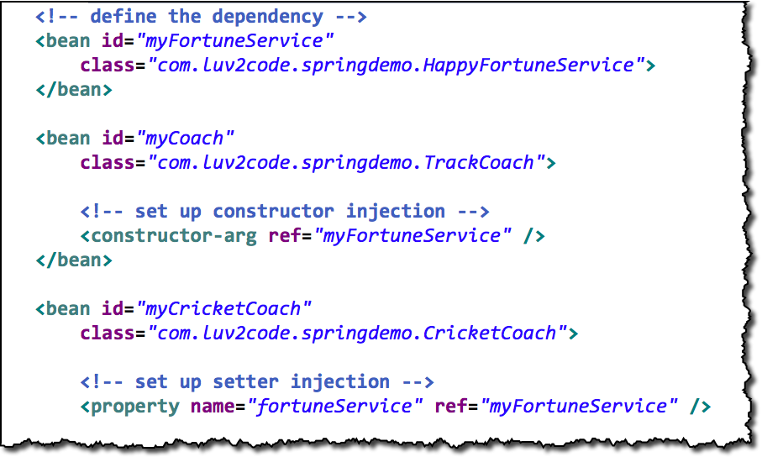
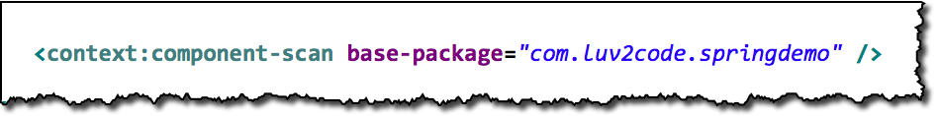
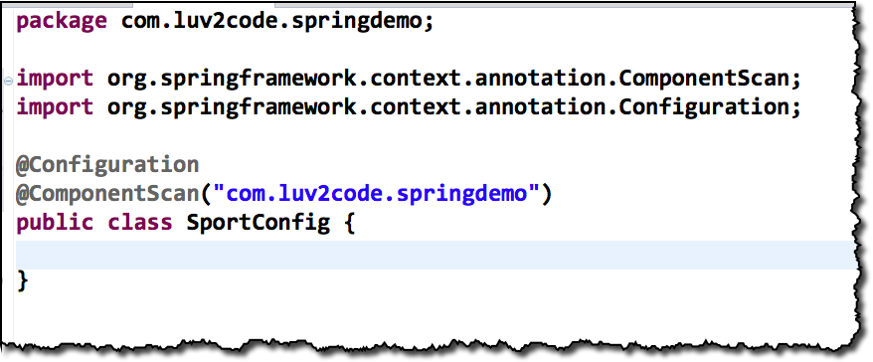
3 Ways of Configuring Spring Container
1. Full XML Config
2. XML Component Scan
3. Java Configuration Class
No XML!

Slide 139
Development Process
Step-By-Step
Create a Java class and annotate as @Configuration
Add component scanning support: @ComponentScan (optional)
Read Spring Java configuration class
Retrieve bean from Spring container

Slide 140

Step 1: Create a Java class and annotate as @Configuration
@Configuration
public class SportConfig {
}

Slide 141

Step 2: Add component scanning support: @ComponentScan
Optional
@Configuration @ComponentScan("com.luv2code.springdemo") public class SportConfig {
}
www.luv2code.com

Slide 142

Step 3: Read Spring Java configuration class
AnnotationConfigApplicationContext context =
new AnnotationConfigApplicationContext(SportConfig.class);

Slide 143

Step 4: Retrieve bean from Spring container
Coach theCoach = context.getBean("tennisCoach", Coach.class);

Slide 144
Defining Beans with Java Code

Slide 145
Defining Beans in Spring
Full XML Config
Java Configuration Class
No XML!

Slide 146

Our New Coach …
No special
annotations
public class SwimCoach implements Coach {
...
}
www.luv2code.com

Slide 147

Our New Coach …
No special
annotations
public class SwimCoach implements Coach {
...
}
Coach
FortuneService

Slide 148
Development Process
Step-By-Step
Define method to expose bean
Inject bean dependencies
Read Spring Java configuration class
Retrieve bean from Spring container

Slide 149

Step 1: Define method to expose bean
@Configuration
public class SportConfig {
@Bean
public Coach swimCoach() {
SwimCoach mySwimCoach = new SwimCoach();
return mySwimCoach;
}
}
www.luv2code.com

Slide 150
Step 1: Define method to expose bean
No component scan
@Configuration
public class SportConfig {
@Bean
public Coach swimCoach() {
SwimCoach mySwimCoach = new SwimCoach();
return mySwimCoach;
}
}

Slide 151

What about our dependencies?
Coach
FortuneService

Slide 152

Step 2: Inject bean dependencies
@Configuration
public class SportConfig {
@Bean
public FortuneService happyFortuneService() { return new HappyFortuneService();
}
@Bean
public Coach swimCoach() {
SwimCoach mySwimCoach = new SwimCoach( happyFortuneService() );
return mySwimCoach;
}
}

Slide 153
Step 3: Read Spring Java configuration class
AnnotationConfigApplicationContext context =
new AnnotationConfigApplicationContext(SportConfig.class);

Slide 154
Step 4: Retrieve bean from Spring container
Coach theCoach = context.getBean("swimCoach", Coach.class);

Slide 155
Injecting Values from Properties File

Slide 156
Read from a Properties File
emailAddress:
team:
properties file
SwimCoach
FortuneService

Slide 157
Development Process
Create Properties File
Load Properties File in Spring config
Reference values from Properties File
Step-By-Step

Slide 158
Step 1: Create Properties File
File: sport.properties
foo.email=myeasycoach@luv2code.com foo.team=Awesome Java Coders

Slide 159

Step 2: Load Properties file in Spring config
File: SportConfig.java
@Configuration @PropertySource("classpath:sport.properties") public class SportConfig {
…
}

Slide 160


Step 3: Reference Values from Properties File
File: SwimCoach.java
public class SwimCoach implements Coach {
@Value("${foo.email}") private String email;
@Value("${foo.team}") private String team;
...
foo.email=myeasycoach@luv2code.com foo.team=Awesome Java Coders
}

